Slide 1
HOW TO GET C/C++ WORKING WITH WEB ASSEMBLY
PREPARED BY NWOKO PAUL

Slide 2
INTRODUCTION
WebAssembly is a new type of code that can be run in modern browsers and provides new feature and major gains in performance.
It is not intended to be writteng by hand, rather it is designed to be an effective compilation target for source languages like c/c++, c#, rust etc.
In this tutorial i will be demostrating how to compile a c application to web assembly using Emscripten tool and how to run on a browser using vscode live server.

Slide 3
Seting up the Emscripten work enviroment
# Get the emsdk repo
git clone https://github.com/emscripten-core/emsdk.git
# Enter that directory
cd emsdk
# Fetch the latest version of the emsdk (not needed the first time you clone)
git pull
# Download and install the latest SDK tools.
./emsdk install latest
# Make the "latest" SDK "active" for the current user. (writes .emscripten file)
./emsdk activate latest
# Activate PATH and other environment variables in the current terminal
source ./emsdk_env.sh
Reference site: https://emscripten.org/docs/getting_started/downloads.html

Slide 4
COMPILING C CODE TO WASM
Reference site: https://developer.mozilla.org/en-US/docs/WebAssembly/C_to_wasm#prerequisites
Here i Compile my C application to wasm and creating HTML to run our code in, plus all the JavaScript "glue" code needed to run the wasm in the web environment.
Now, using the terminal window I used to enter the Emscripten compiler environment, I navigated to the directory i saved my c source file(), and ran the following command:
emcc hello.c -s WASM=1 -o hello.html
-s WASM=1 — Specifies that we want wasm output. If we don’t specify this, Emscripten will just output asm.js, as it does by default.
-o hello.html — Specifies that we want Emscripten to generate an HTML page to run our code in (and a filename to use), as well as the wasm module and the JavaScript "glue" code to compile and instantiate the wasm so it can be used in the web environment.
Emscripten will generate the following file in the c source directory as show in the next slide.

Slide 5
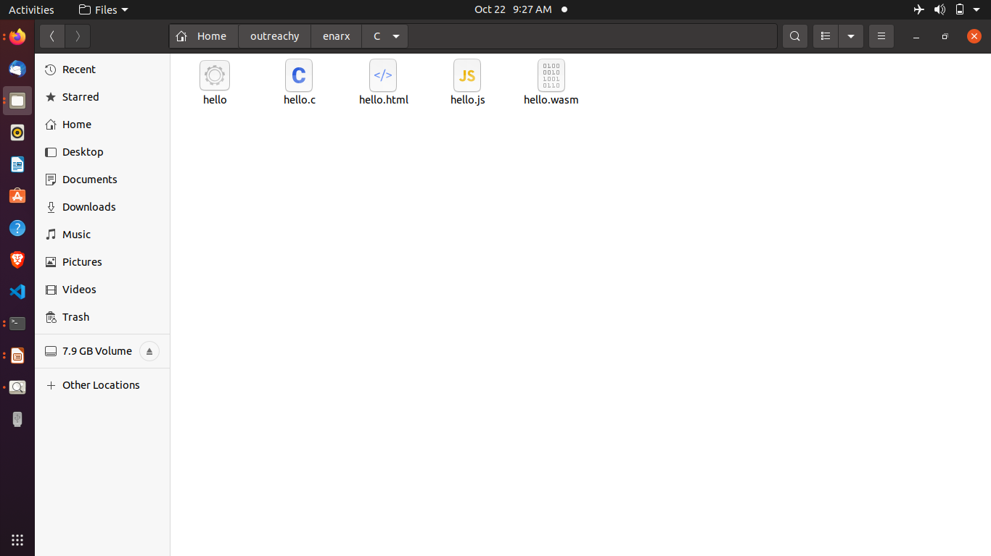
C source directory now contains a .html, .js, and .wasm file as shown in the

Slide 6
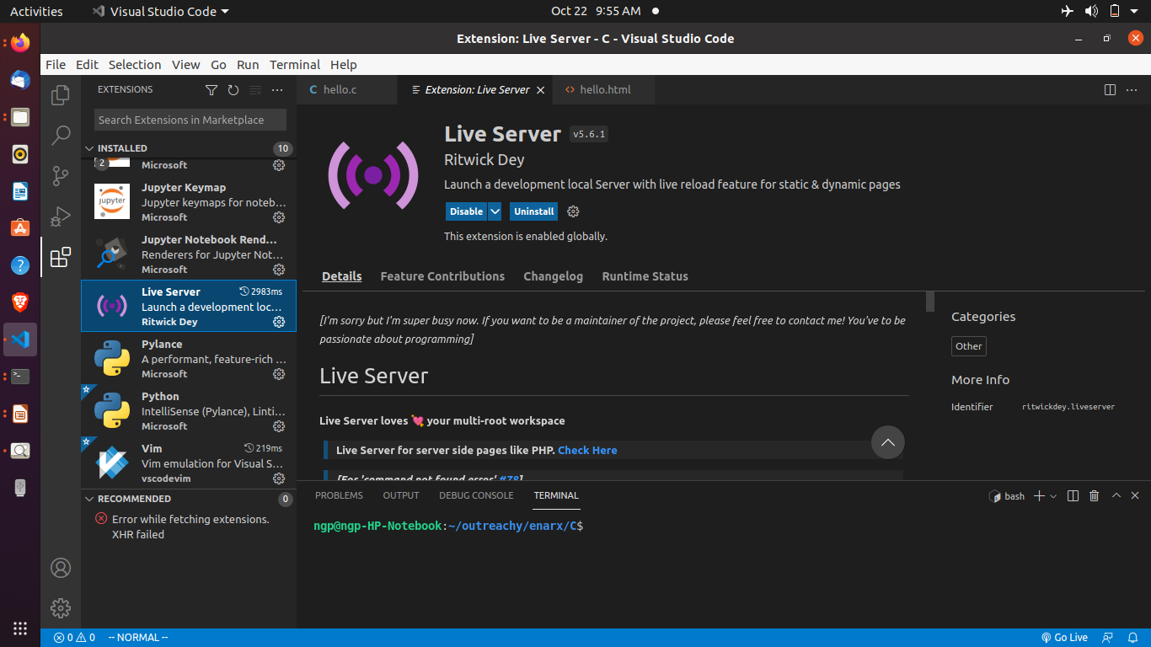
Setting up local server on my PC
I’ll need a server to run the hello.html generated file on my browser.
My code editor of choice is vscode. So, I installed live server extension in my vscode editor program.
Reference site: https://github.com/ritwickdey/vscode-live-server

Slide 7
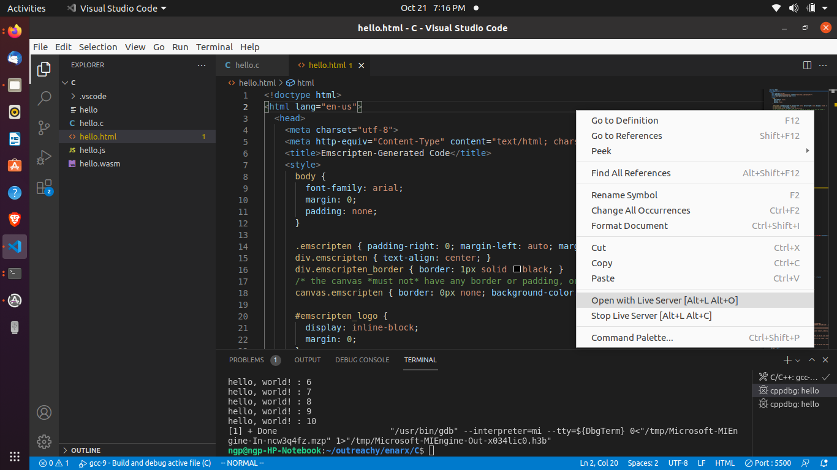
To run the wasm file on a browser, i opened the hello.html on vscode, right clicked on it and clicked on “open with live server” as shown below

Slide 8
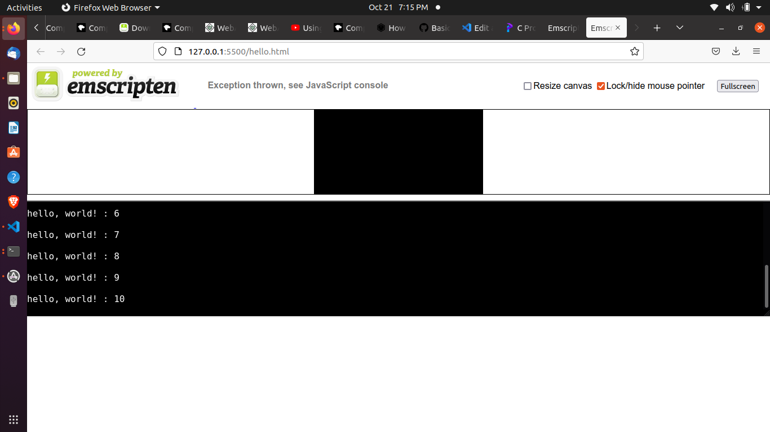
Here is my c application running on a local sever

Slide 9
Reference sites
Downloading Emscripten SDK:https://emscripten.org/docs/getting_started/downloads.html
Compiling c/cpp source to WASM: https://developer.mozilla.org/en-US/docs/WebAssembly/C_to_wasm#prerequisites
Installing vscode liveserver:
https://github.com/ritwickdey/vscode-live-server

